Slide 1
SYSTEMs ANALYSIS AND DESIGN Chap 9 – The Movement To objects

Slide 2
Recap on SAD
Core set of skills that all system analysts need to know (regardless of methodology)
All information systems projects move. through the four phases: Planning, Analysis, Design, and Implementation.
All projects require analysts to gather requirements, model the business needs, and create blueprints for how the system should be built.
Notes:
Types of Requirements:
Functional: What the system must do (features, processes).
Non-functional: Performance, security, usability, reliability, scalability.
Requirement Gathering Techniques: Interviews, observations, surveys, document analysis, JAD sessions, prototyping.

Slide 3
Chapter 9 Objectives
Explain the basic concepts of the object approach and UML.
Understand how to create:
Use Case diagram
Sequence diagram
Class diagram
Behavioral state machine diagram
Notes:
In this chapter, we will learn about object-oriented analysis, which is another way to document, analyze, and model the system requirements in information system.

Slide 4
Object-Oriented Analysis And Design (OOAD)
Object-oriented systems focus on capturing the structure and behavior of information systems in little modules (objects) that encompass both data and processes.
The object-oriented approaches can use any of the traditional methodologies (e.g., waterfall development, parallel development, etc.), and are most associated with an iterative development RAD methodology.

Slide 5
Unified Modeling Language (UML)
Unified Modeling Language (UML) is a standard set of diagramming techniques that provide a graphical representation to model systems development project.
Object-oriented systems analysis and design use UML to depict a system.
UML has different diagrams to show various views of the system.
It is a blueprint that supports software engineering activities from analysis to implementation.
UML models can be used during requirements gathering, system design, and even system maintenance.

Slide 6
Benefits of Using UML
UML provides a common visual language that can be understood by developers, analysts, designers, and even non-technical stakeholders.
It makes it easier to analyze and communicate system requirements, as diagrams can simplify complex information.
Helps with design validation before any code is written, saving time and effort later in the development cycle.
Enables early detection of design flaws and inconsistencies.
Supports Object-Oriented Analysis and Design (OOAD), enabling teams to design reusable, modular, and maintainable software.
UML is tool-independent—meaning it can be applied in Agile, Waterfall, or hybrid project methodologies.

Slide 7
Unified Modeling Language Version 2.0
The objective of the Unified Modeling Language (UML) is to provide a common vocabulary of object-oriented terms and diagramming techniques.
The diagrams are broken into two major groupings:
Structure diagrams - for representing data and static relationships in an information system. It describes what exists in the system rather than how it behaves.
Behavior diagrams - for representing dynamic relationships among the objects. It illustrate how the system behaves over time—how components interact and how processes unfold.

Slide 8
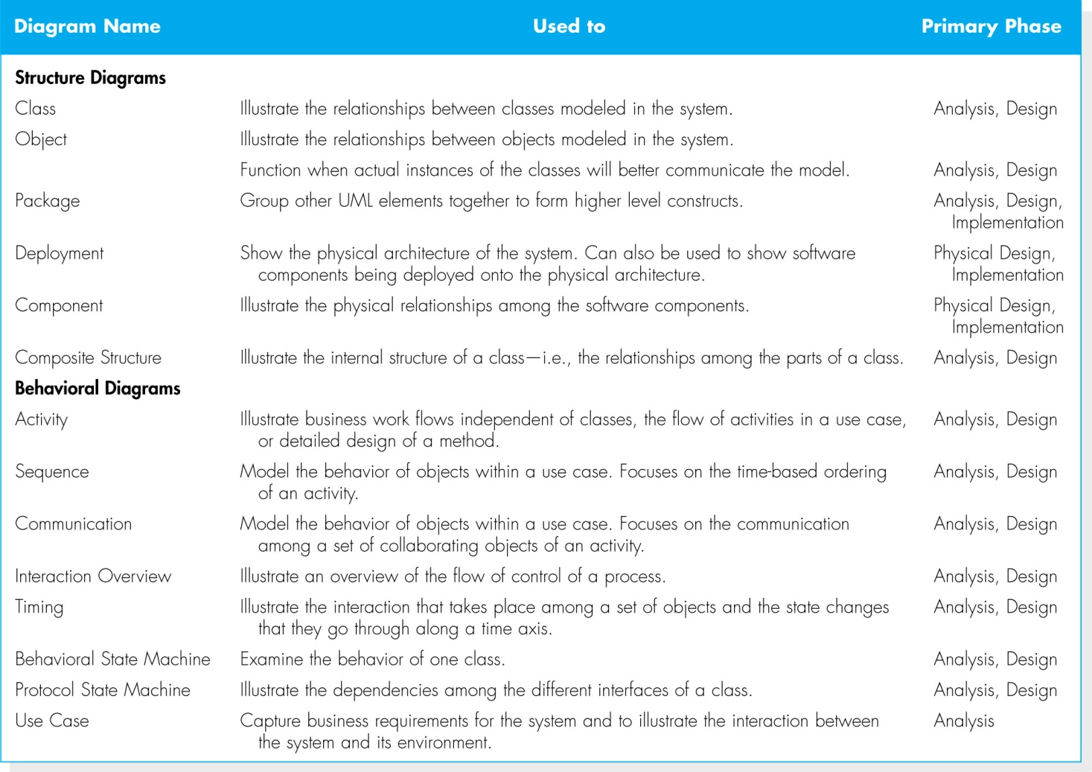
UML 2.0 Diagram Summary

Slide 9
Common UML Diagrams
Diagram Type | Purpose | Example Application
Use Case Diagram | Identify user roles, interactions, and system boundaries | User login, registration, report generation
Sequence Diagram | Represent message flow between system components | Student requests course information
Activity Diagram | Model workflows, decisions, and parallel activities | Attendance recording and approval process
State Machine Diagram | Describe object state changes over time | Student status: Active → Graduated → Suspended
Class Diagram | Define data structure and relationships between entities | Student, Course, and Enrollment classes

Slide 10
Recommended Order for Drawing UML Diagrams
Below is a typical and practical order used in teaching and real-world projects:
Requirements Understanding Phase
Start with diagrams that help understand what the system should do.
Use Case Diagram → identifies functional requirements and system boundaries.
Activity Diagram (Optional) → models the workflow of key use cases.
💡These diagrams focus on what the system should do, not how.

Slide 11
Recommended Order for Drawing UML Diagrams (cont.)
2. Analysis Phase
Move into analyzing the structure and interactions in more detail.
Class Diagram → defines key classes, attributes, and relationships.
Sequence Diagram → shows how objects interact over time for specific use cases.
Communication Diagram (alternative to sequence) → emphasizes object relationships during interactions.
💡These diagrams start revealing how the system will achieve the use cases.

Slide 12
Recommended Order for Drawing UML Diagrams (cont.)
3. Design Phase
Focus on the architecture and system behavior.
State Machine Diagram → models the lifecycle of key objects (useful for reactive systems).
Component Diagram → shows system components and their interfaces.
Deployment Diagram → shows physical architecture (servers, devices, nodes).
💡These diagrams prepare for implementation and deployment.

Slide 13
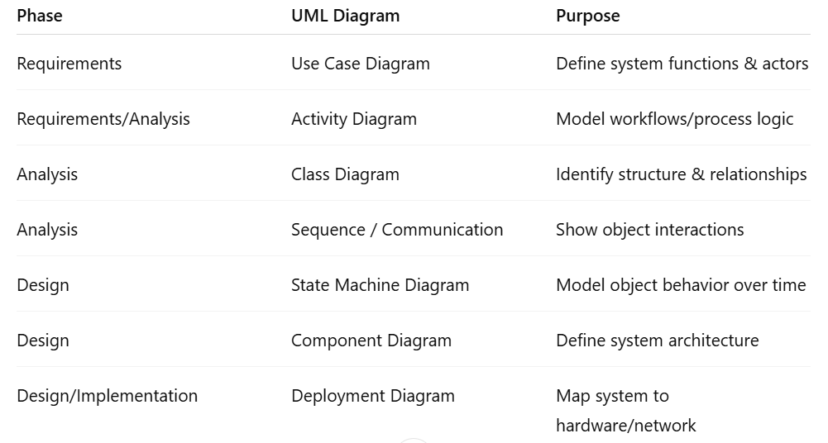
Recommended Order for Drawing UML Diagrams (cont.)

Slide 14
USE CASE DIAGRAM

Slide 15
Use Cases
The primary driver for all UML diagramming techniques
Depicts activities performed by the users
Describe basic functions of the system:
What the user can do
How the system responds
Use cases are building blocks for continued design activities
Each use-case describes 1 and only 1 function
Notes:
- An analyst can use the use case diagram to better understand the functionality of a system at very high level.
- Typically, the use case diagram is drawn when the analyst is gathering and defining requirement for the system since it provides simple and straightforward way of communicating to the users exactly what the system will do.

Slide 16
What is a Use Case?
A formal way of representing how a business system interacts with its environment
Illustrates the activities that are performed by the users of the system
A scenario-based technique in the UML
A sequence of actions a system performs that yields a valuable result for a particular actor.

Slide 17
Creating A Use Case Diagram
Steps in creating a use-case diagram
Review the requirements definition
Identify the subject’s boundaries
Identify the primary actors and their goals
Identify the business processes and major use-cases
Add the relationship between actor and use-cases
Carefully review the current set of use-cases
Split or combine some to create the right size
Identify additional use-cases

Slide 18




Business Process Identification With Use-Cases
Elements of Use-Case Diagrams
Actors: users or other interacting systems
Associations: lines to connect actors and use-cases
Interactions, inclusions, extensions or generalizations
Use-case: a major process in the system that gives a benefit to the users
Subject boundary: a named box that depicts the scope of the system
https://www.youtube.com/watch?v=4emxjxonNRI

Slide 19
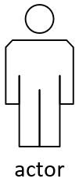

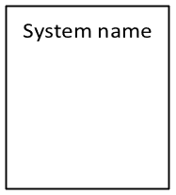
Elements Of Use Case Diagram
Term & definition | Symbol
1. Actor Entity who interacts with the system. Supposed to be outside of system boundary. Depicts by a stick-man figure. Primary actor is the entity that performs initiation task towards the system. Secondary actor is the entity that performs reactionary task towards system. Normally, primary actor (left side) and secondary actor (right side) are in contrary positioned.
2. Use case The functionality or services provide by the system. All use cases should be within system boundary and named with verb. Depicts by an oval shape.
3. System boundary A simple rectangular shape that represents the developed system or a website or an app. Labelled with system’s name on the top of system’s boundary.

Slide 20
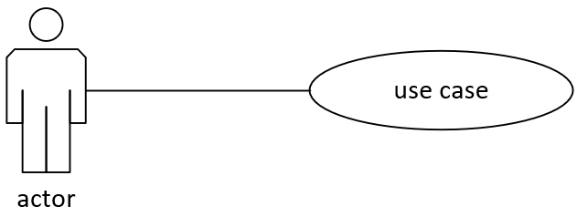
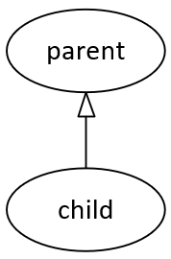
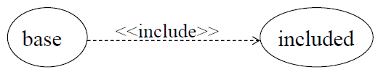

Elements Of Use Case Diagram
Term & definition | Symbol
4. Association relationship A solid line links between the actor and the use case. An actor must be associated with at least one use case Multiple actors can be associated with a single use case.
4. Generalization relationship The solid line with an arrow pointing from the child to the parent. One element “is based on” the other element. Child “is based on” on the parent.
4. Include relationship Dashed line with include text written between double pairs of pointy brackets and an arrow pointing from base to the included case. Base use case is incomplete by itself and the include case is required, hence it is a mandatory behavior.
4. Extend relationship Dashed line with extend text written between double pairs of pointy brackets and an arrow pointing from extending case to the base case. Base use case is complete by itself and the extending case is optional, hence it is an optional behavior.

Slide 21
What is an Actor?
An Actor is outside or external to the system.
It can be a:
- Human
- Peripheral device (hardware)
- External system or subsystem
- Time or time-based event
Represented by stick figure.
Use Cases describe scenarios that describe the interaction between users of the system (the actor) and the system itself.

Slide 22
Questions for Identifying People Actors
Who is interested in the scenario/system?
Where in the organization is the scenario/system be used?
Who will benefit from the use of the scenario/system?
Who will supply the scenario/system with this information, use this information, and remove this information?
Does one person play several different roles?
Do several people play the same role?
Notes:
Actors
7) Does one person play several different roles?
May have an actor for each role
8) Do several people play the same role?
Only use one actor per role (no matter how many people play that role)
Identifying actors is an iterative process
Defining how an actor interacts with the system may clarify whether there are duplicate actors or not

Slide 23
Questions for Identifying Other Actors
What other entity is interested in the scenario/system?
What other entity will supply the scenario/system with this information, use this information, and remove this information?
Does the system use an external resource?
Does the system interact with other system?
Notes:
Actors
7) Does one person play several different roles?
May have an actor for each role
8) Do several people play the same role?
Only use one actor per role (no matter how many people play that role)
Identifying actors is an iterative process
Defining how an actor interacts with the system may clarify whether there are duplicate actors or not

Slide 24
Use Case - Example
Here is a scenario for a medical clinic.
A patient calls the clinic to make an appointment for a yearly checkup. The receptionist finds the nearest empty time slot in the appointment book and schedules the appointment for that time slot.

Slide 25
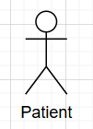
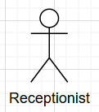
1. Who are the Actors?
As we read the scenario, what or who is the actor?
A patient calls the clinic to make an appointment for a yearly checkup. The receptionist finds the nearest empty time slot in the appointment book and schedules the appointment for that time slot.
.
Primary Actor:
Patient
Secondary Actor:
Receptionist

Slide 26
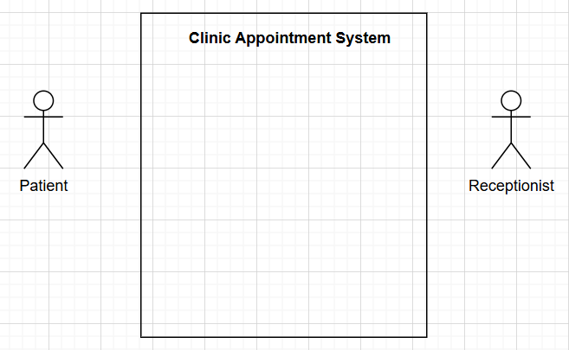
2. What is the System Boundary?
The system boundary defines the scope of the system. It separates:
Inside the system → Use cases (functions the system provides)
Outside the system → Actors (users or external systems that interact with the system)
So, the System Boundary is Clinic Appointment System.
Notes:
Boundary
A boundary rectangle is placed around the perimeter of the system to show how the actors communicate with the system
System boundary: A system boundary defines the scope of what a system will be. A system cannot have infinite functionality. So, it follows that use cases also need to have definitive limits defined. A system boundary of a use case diagram defines the limits of the system. The system boundary is shown as a rectangle spanning all the use cases in the system.
Other use cases in this lecture also show the system boundary of the clinic application. The use cases of this system are enclosed in a rectangle. Note that the actors in the system are outside the system boundary.
The system boundary is potentially the entire system as defined in the problem statement. But this is not always the case. For large and complex systems, each of the modules may be the system boundary. For example, for an ERP system for an organization, each of the modules such as personnel, payroll, accounting, and so forth, can form the system boundary for use cases specific to each of these business functions. The entire system can span all of these modules depicting the overall system boundary.
.

Slide 27

3. What are the Use Cases?
A use case is a description of how a user (actor) interacts with a system to achieve a specific goal.
It focuses on what the system should do, not how it is implemented.
May contain several “paths” that a user can take while interacting with the system. Each path is referred to as a scenario.
A use case is a functional requirement that describes a complete sequence of actions performed by the system in response to a request from an actor.
Represents one goal or task that the user wants to accomplish
Shows the interaction between actor and system
Describes the steps and system responses
Helps identify and define system functionality

Slide 28
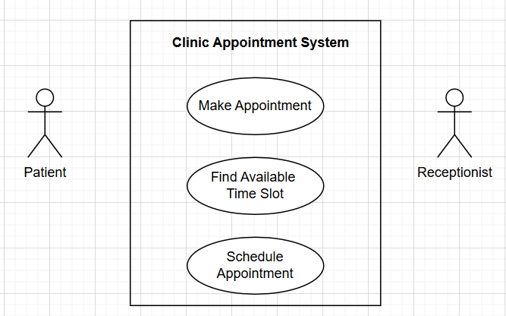
3. What are the Use Cases? (Answer)
Make Appointment
Find Available Time Slot
Schedule Appointment
Notes:
Make Appointment
Triggered when the patient calls to request a yearly checkup
Find Available Time Slot
The receptionist searches the appointment book for the nearest empty time slot. This is part of scheduling and may be included as a sub–use case.
Schedule Appointment
After finding the empty slot, the receptionist schedule and confirms the appointment.

Slide 29

4. What are Relationships?
Represent communication between actor and use cases.
Depicted by line or double-headed arrow line. Navigation direction of an association represents who is initiating the communication.
Also called association relationship
Make
Appointment
Notes:
Use Case Relationship
Association relationship
May exist between actor and a use case
Often referred to as a communicate association
Navigable in both directions (actor to use case and use case to actor)
Some use just a line
Others use a double-headed arrowhead
Navigable in only one direction (actor to use case OR use case to actor)
Use a arrowhead where arrowhead denotes the direction of communication
Navigation direction of an association represents who is initiating the communication

Slide 30
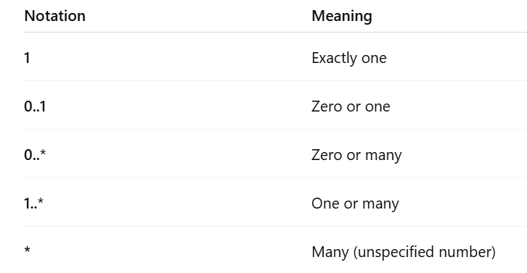
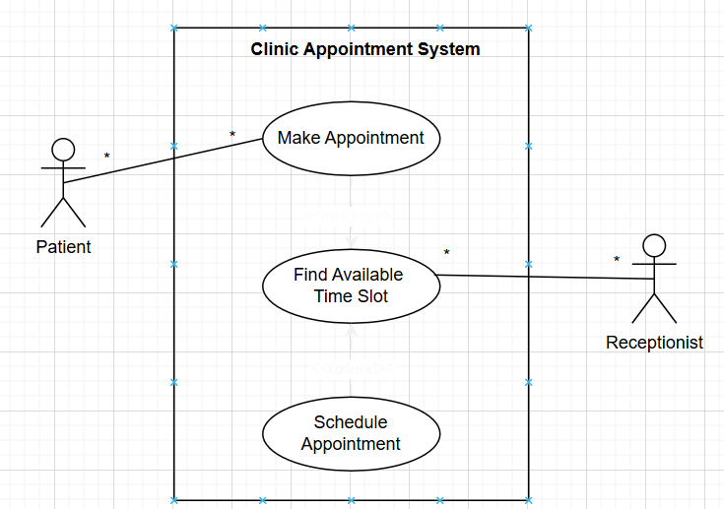
Relationships: Multiplicity
Multiplicity tells you the number of times an actor can participate in a use case.
But not consistency shown on all use-case diagrams.
Notes:
Example Use Case
ACTORS
Represented by a stick figure
named
USE CASE
Represented by an oval
Named (POORLY NAMED; should be verb phrase)
RELATIONSHIP
2-way association

Slide 31
Other Types of Relationships for Use Cases
Generalization
Include
Extend
Notes:
Inheritance

Slide 32
Generalization Relationship
Represented by a line and a hollow arrow
From child to parent
Parent use case
Child use case
Notes:
Inheritance
A use case generalization shows that one use case is simply a special kind of another.
A clinic may have a use case such as Pay Bill which would be a parent use case and Bill Insurance which is the child.
A child can be substituted for its parent whenever necessary.
Generalization appears as a line with a triangular arrow head toward the parent use case.

Slide 33
Include Relationship
Represents the inclusion of the functionality of one use case within another (mandatory)
Arrow is drawn from the base use case to the used use case
Write <<include>> above arrowhead line
Notes:
Include relationship
Notice that ONLY between use cases (not between actors)
MANDATORY functional
Multiple use cases may share pieces of the same functionality
Rather than have duplicate functionality in several use cases
Put shared functionality in one use case and show relationship between it and other use cases that “uses” its functionality
Depicted by arrowhead with word “<<include>>” above it
Include relationships factor use cases into additional ones.
Includes are especially helpful when the same use case can be factored out of two different use cases.
If a clinic had a cases of Make Appointment and Request Medication.
Both might include Check Patient Record as a subtask.
Both would include a call to the use case Check Patient Record.
We don’t want to write it twice we simply want to include in as a call from both.
In the diagram,
include notation is a dotted line beginning at base use case ending with an arrows pointing to the include use case.
The dotted line is labeled <<include>>.

Slide 34
Extend relationship
Represents the extension of the use case to include optional functionality
Arrow is drawn from the extension use case to the base use case
Write <<extend>> above arrowhead line
Notes:
Use Case Relationship
Extend relationship
Used to show optional behavior (behavior that is run only under certain circumstances)
Depicted by arrowhead with word “<<extend>>” above it
An extend relationship indicates that one use case is a variation of another.
This is often used when much of the same code may be in both only one extends the functionality somewhat.
A typical example is a add record to the database and modify that record.
So an add student is similar to a modify student so I may reuse some of the code.
Extend notation is a dotted line, labeled <<extend>>, and with an arrow toward the base case.
The extension point, which determines when the extended case is appropriate, is written inside the base case.

Slide 35
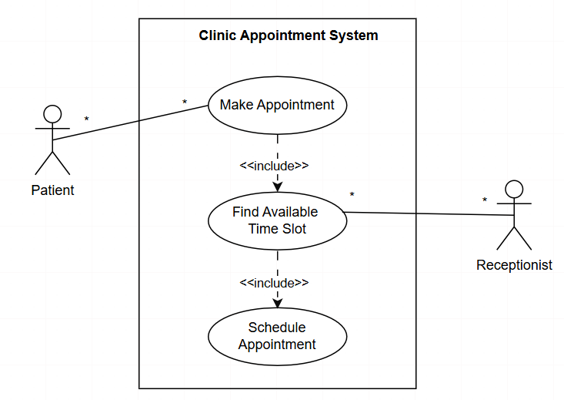
Example: Final Use Case
Notes:
Example Use Case
ACTORS
Represented by a stick figure
named
USE CASE
Represented by an oval
Named (POORLY NAMED; should be verb phrase)
RELATIONSHIP
2-way association

Slide 36
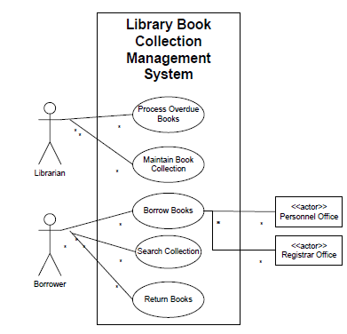
Example of USE CASE DIAGRAM

Slide 37
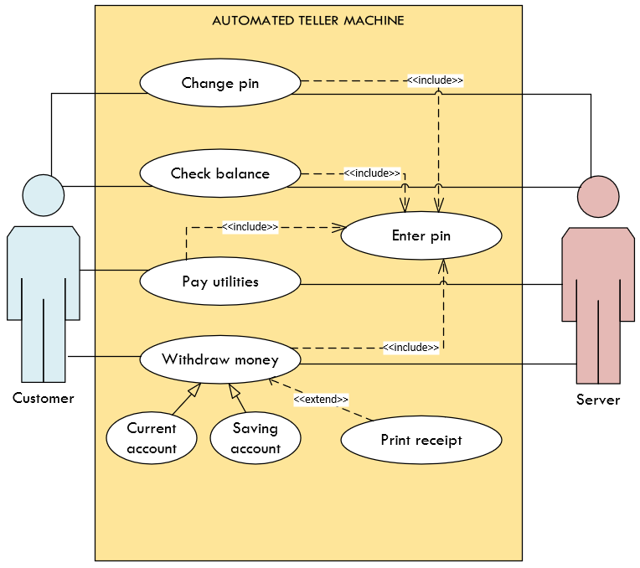
Example of USE CASE DIAGRAM

Slide 38

LETS TRY TO DRAW
Create a use-case diagram that would illustrate the following use-cases for the mobile banking application (Maybank2U).
Customer need to login before making any transaction
Customer can view their bank statement
Customer can transfer fund
Customer can make payment

Slide 39
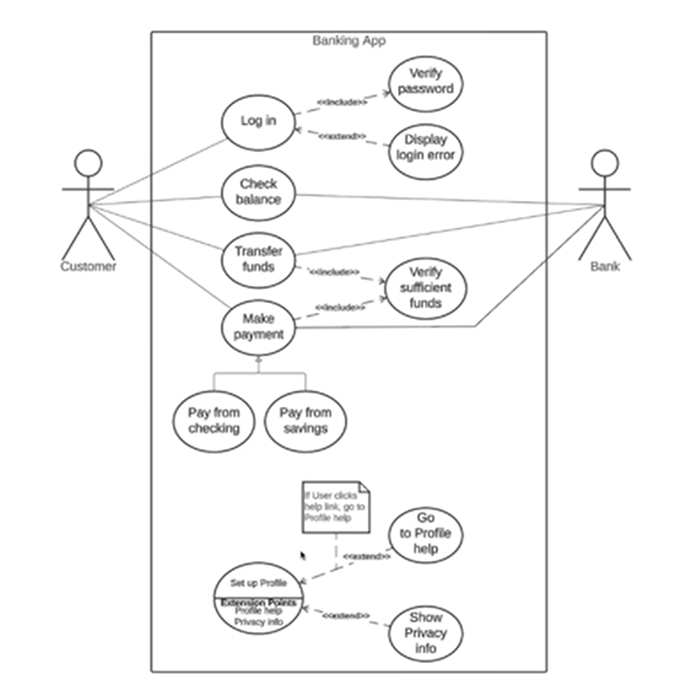
LETS TRY TO DRAW
Create a use-case diagram that would illustrate the following use-cases for the mobile banking application (Maybank2U).
Customer need to login before making any transaction
Customer can view their bank statement
Customer can transfer fund
Customer can make payment
Answer

Slide 40
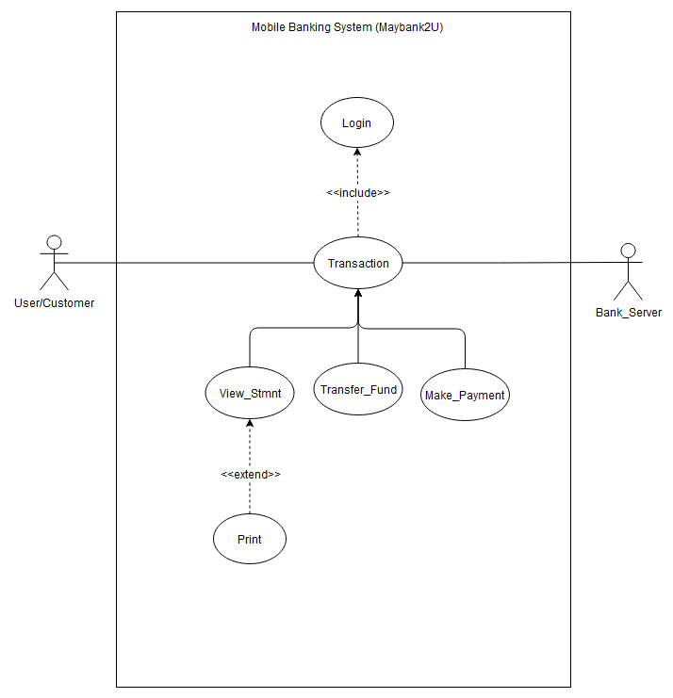
Answer

Slide 41
Elements of a Use Case Description
Overview:
Name, ID Number, Type, Primary Actor, Brief Description, Importance Level, Stakeholder(s), Trigger(s)
Relationships:
Association: Communication between the use case and the actors
Extend: Extends the functionality of a use case
Include: Includes another use case
Generalization: Allows use cases to support inheritance
Flow of events
Normal flow: the usual set of activities
Sub-flows: decomposed normal flows to simplify the use-case
Alternate or exceptional flows: those not considered the norm
Optional characteristics (complexity, time, etc.)

Slide 42
Creating Use-Case Descriptions
Pick a high priority use-case and create an overview:
List the primary actor
Determine its type (overview or detail; essential or real)
List all stakeholders and their interests
Determine the level of importance of the use-case
Briefly describe the use-case
List what triggers the use-case
List its relationship to other use-cases
Fill in the steps of the normal flow of events required to complete the use-case

Slide 43
Creating Use-Case Descriptions (cont.)
Ensure that the steps listed are not too complicated or long and are consistent in size with other steps
Identify and write the alternate or exceptional flows
Carefully review the use-case description and confirm that it is correct
Iterate over the entire set of steps again

Slide 44
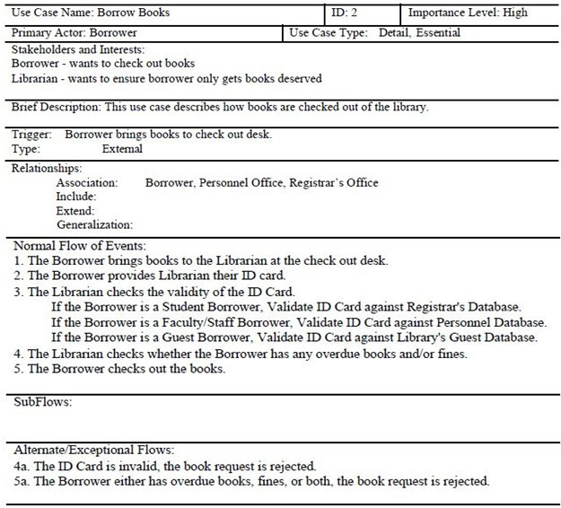
Example Use-Case Description

Slide 45
Example Use-Case Description
New Registration
Pre-condition Patient who did not have member’s account Patient who wanted to make appointment
Main Scenario Patient will choose menu options – new registration System will shows the registration form and patient needs to fill in the form. (A1: Control the information errors) Shows “Registration Successful” message when registration complete. Patient needs to log in to the system using the registered username and password to see the personal information details and others menu.
Alternatives: A1: Control the information errors A1 sequence has started during No (2) in main scenario. System will identified the errors and error messages will appears. The flow will start again at No (2).
Post-condition: Member’s information will be stored in database.

Slide 46
Verifying & Validating a Use-Case
Use-cases must be verified and validated before beginning structural and behavioral modeling
Utilize a walkthrough:
Perform a review of the models and diagrams created so far
Performed by individuals from the development team and the client (very interactive)
Facilitator: schedule and set up the meeting
Presenter: the one who is responsible for the specific representation being reviewed
Recorder (scribe) to take notes and especially to document errors

Slide 47
SEQUENCE DIAGRAM

Slide 48
SEQUENCE DIAGRAM
https://www.youtube.com/watch?v=pCK6prSq8aw&t=11s
Sequence diagram illustrates the objects that participate in a use case and the messages that pass between them over time for one use case.
A sequence diagram is a generic sequence diagram that shows all possible scenarios of a use case. Each of it which depicts a single scenario within the use case.
A sequence diagram consist of 6 components:
Actor
Object
Lifeline
Focus of control
Message
Object destruction

Slide 49
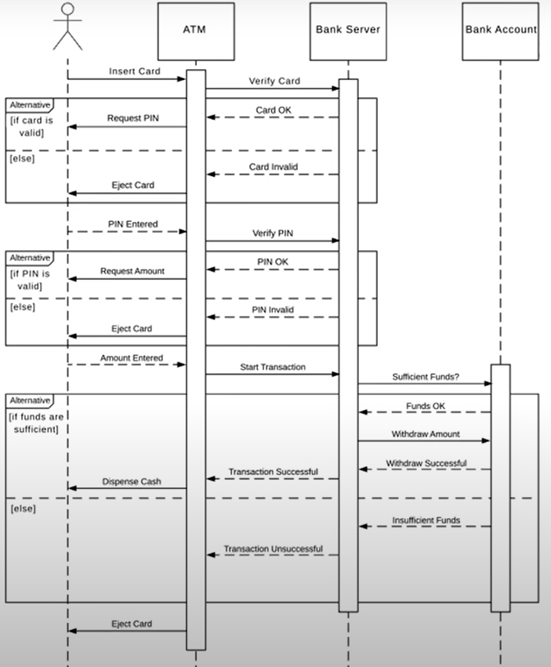
EXAMPLE OF SEQUENCE DIAGRAM
Actor
Object
Lifeline
Focus of control
Fragment
Label all of the components of sequence diagram.
Message
X
X
Object destruction

Slide 50
ELEMENTS OF SEQUENCE DIAGRAM
Besides the main elements, identify the other elements of a sequence diagram:
Types of message
Synchronous message
Return message – when an object sends a message back aka reply msg commonly reply to an earlier msg
Self message
Asynchronous message
Types of Fragment
Loop fragment
Alternative fragment – symbolize choices between two or more msg sequences it is usually mutually exclusive it is either A or B. if else stmt.
Optional fragment

Slide 51
LETS TRY TO DRAW
Create a sequence diagram that would illustrate one amongst the use-cases for the mobile banking application.
Example:
A use case to check balance of account
A use case to transfer fund

Slide 52
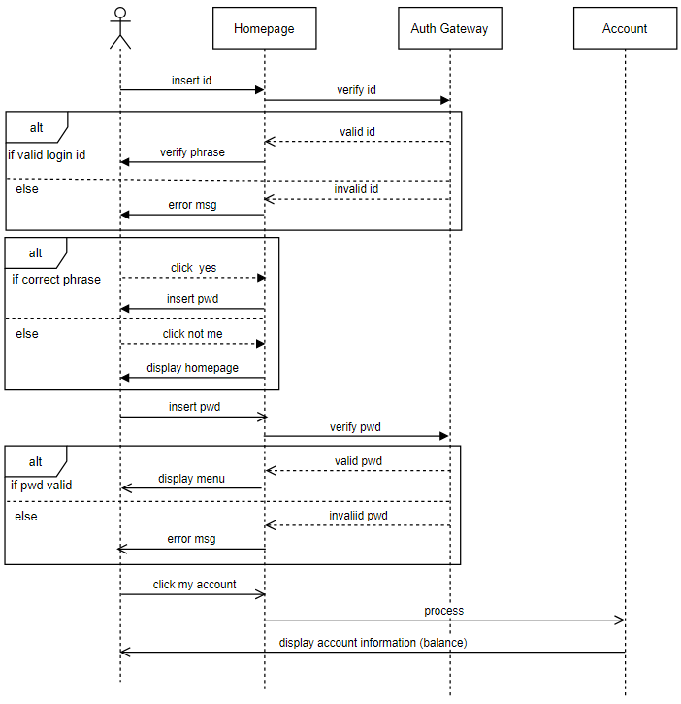
A use case to check balance of account.

Slide 53
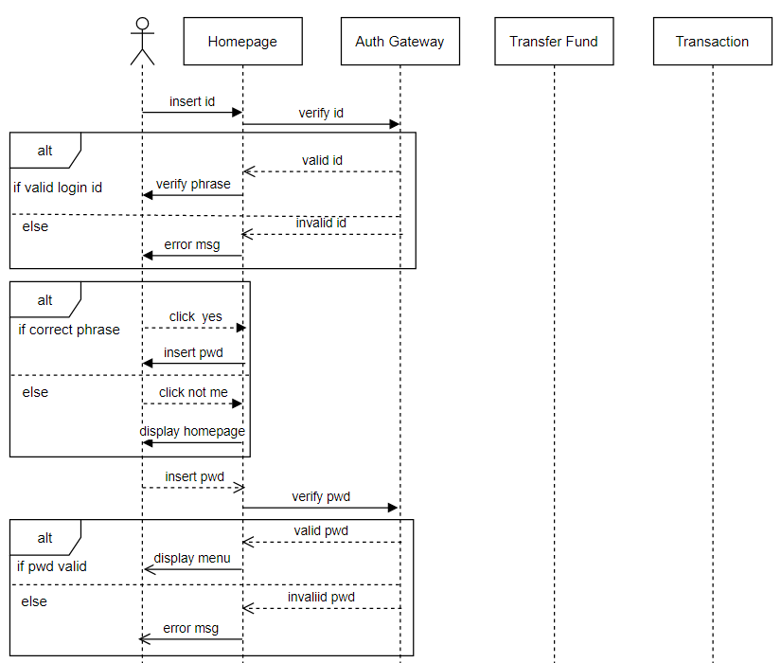
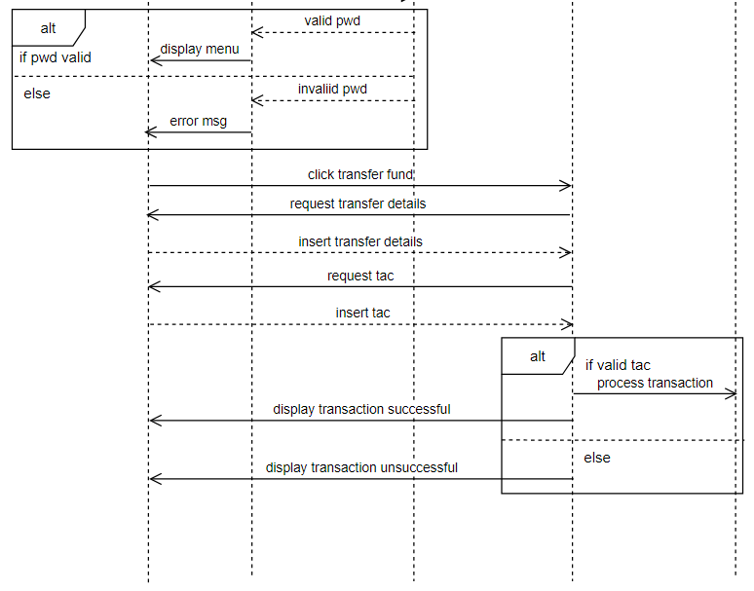
A use case to transfer fund

Slide 54
CLASS DIAGRAM

Slide 55
CLASS DIAGRAM
https://www.youtube.com/watch?v=6XrL5jXmTwM&t=19s
Class diagram is a model that supports the static view of the evolving system.
It shows the classes and the relationship among the classes.
A class refers to the people, place, thing, or any entities of a system.
A class diagram consist of 4 components:
Class
Attribute
Operation
Association

Slide 56
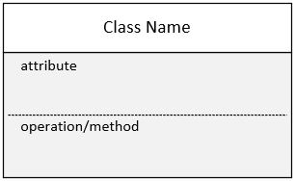
ELEMENTS OF CLASS DIAGRAM
Term & definition | Symbol
1. CLASS Represent a kind of person, place, or thing, about which the system must capture or store information. Drawn using 3-parts of rectangular shape which are divided into top, middle, bottom compartment. The top compartment has the class’s name being written. The middle compartment has the list of attributes being written. The bottom compartment has the list of operations being written.

Slide 57
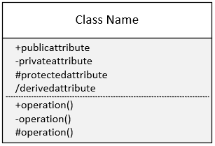
ELEMENTS OF CLASS DIAGRAM
Term & definition | Symbol
2. ATTRIBUTE An attribute represents the properties or the characteristics of a class. Visibility of an attribute can be set either public, protected, or private. A public attribute is one that is not hidden from other class, shown by placing a + operator at the beginning of the attribute’s name. A protected attribute is one that is hidden from all other classes except its immediate subclasses, shown by placing a # operator at the beginning of the attribute’s name. A private attribute is one that is hidden from all other classes, shown by placing a – operator at the beginning of the attribute’s name. An attribute can also be derived from other attribute, and it is shown by placing a ”slash” / operator before the attribute’s name.

Slide 58
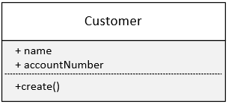
ELEMENTS OF CLASS DIAGRAM
Term & definition | Symbol
3. OPERATION Operations are actions or functions that a class can perform. Operations should be shown with parentheses that are either empty or filled with some value represents a parameter that the operation needs for it to act. The visibility of operation can be designated as public, protected, or private. Default visibility is normally assigned as public.
i) Constructor operation This type of operation used to create new instance of a class. Most of the time, constructor operation is not shown on the class diagram or within its operation compartment.

Slide 59

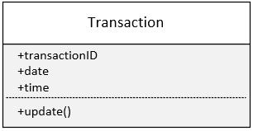
ELEMENTS OF CLASS DIAGRAM
Term & definition | Symbol
3. OPERATION (continued) Operations is also known as the class’s method.
ii) Query operation This type of operation used to call information about the state of an object available to other object, but it will not change the object in any way. If a query operation is simply asks for information from attributes in the class, then it is not shown on the class diagram.
iii) Update operation This type of operation used to change the value of some or all of the object’s attributes, which may result in a change in the object’s state. Unlike the constructor operation and query operation, an update operation is normally declared in the operation compartment.

Slide 60
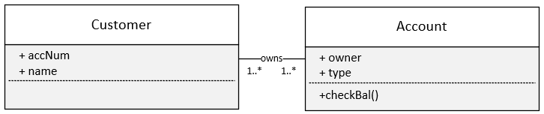


ELEMENTS OF CLASS DIAGRAM
Term & definition | Symbol
4. ASSOCIATION An association represents the relationship between two classes. Drawn by a solid line and labelled with either the name of the association or the roles that classes play in the association. In some class diagrams, a small solid triangle next to the association name will be included to show its relationship direction. Associations are very similar to the relationships that are found on the ERD.
4. ASSOCIATION MULTIPLICITY Association will also have multiplicity, which shows how a class can be associated with another classes.
i) Exactly one Representation: 1
ii) Zero or more Representation: 0..*

Slide 61




ELEMENT OF CLASS DIAGRAM
Term & definition | Symbol
4. ASSOCIATION MULTIPLICITIY (continued)
iii) One or more Representation: 1..*
iv) Zero or one Representation: 0..1
v) Specified range Representation: 2..4
vi) Multiple, disjoint ranges Representation: 1..3,5

Slide 62
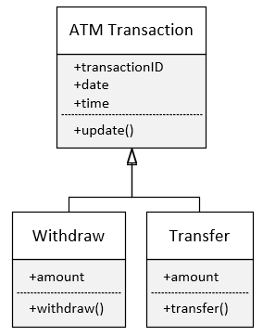


ELEMENT OF CLASS DIAGRAM
Term & definition | Symbol
4. TYPES OF ASSOCIATION Most of the times, classes are related through a normal association, but there are several association cases that you will see quite often: generalization, aggregation, and composition.
a. Generalization It is a type of relationship that represents a class inherits another class. It is used when a class is kind of other class. It is shown as a solid line from child class to parent class with a hollow arrow pointing to the parent class.
b. Aggregation It is a type of relationship that represents a class comprises of other class. It is used when a class is part of other class. A solid line from child to parent symbolized by a clear white diamond.
c. Composition It is strong version of aggregation. It is used when a class is made of other class. A solid line from child to parent symbolized by a black diamond.

Slide 63
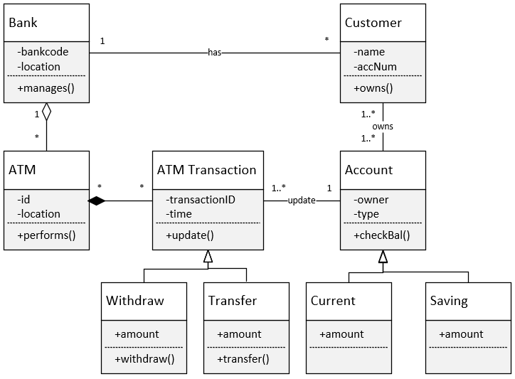
EXAMPLE OF CLASS DIAGRAM

Slide 64
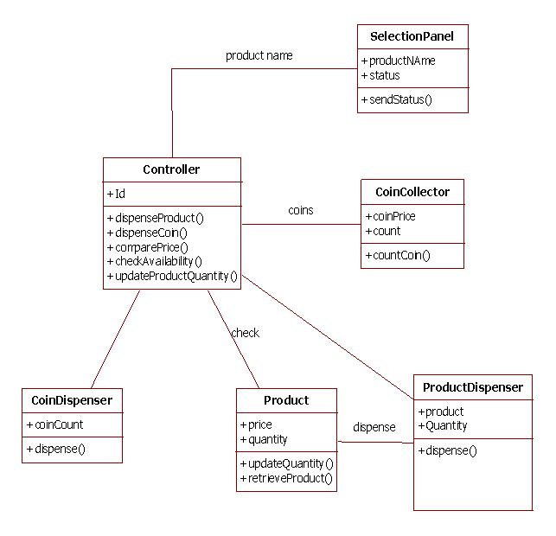
EXAMPLE OF CLASS DIAGRAM

Slide 65
CREATING A CLASS DIAGRAM
Steps in creating a class diagram
Identify classes
Identify attributes and operations
Draw association between class
Lets try to draw!!
A class diagram that would illustrate a complete application of mobile banking system.
…programming is not about typing, it’s about thinking, …

Slide 66
ANSWER FOR CLASS ACTIVITY 1
Some statement to describe situation of said system as to initiate a class diagram
A customer can have more than one bank account which can be either saving or current type.
A customer can have one online account.
An online account may be created of the bank account.
Under single online account many transactions can be made such as pay bill, transfer money, and mobile reload.

Slide 67
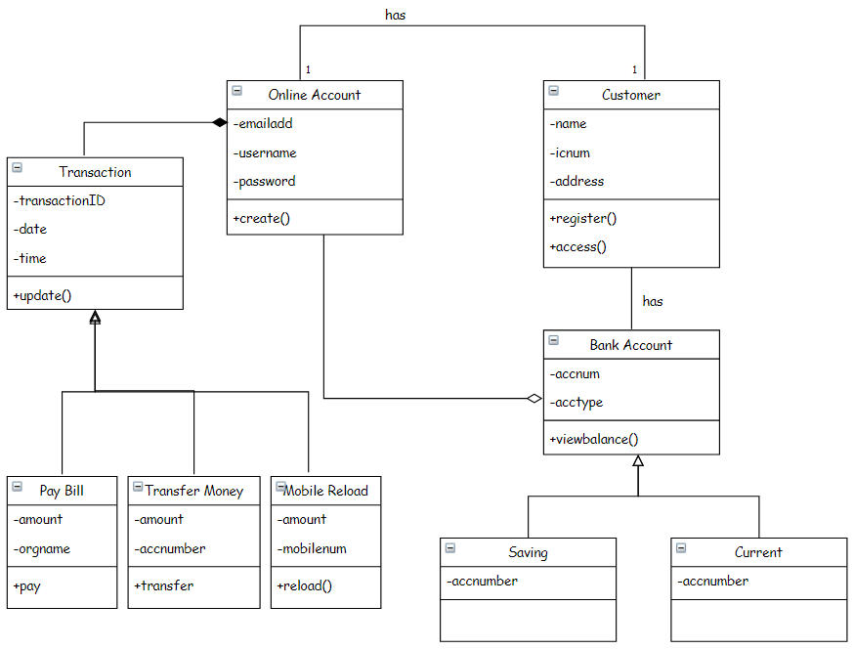
ANSWER FOR CLASS ACTIVITY 1

Slide 68
ANSWER FOR CLASS ACTIVITY 2
Some statement to describe situation of said system (online shopping system) as to initiate a class diagram
A user able to view items for sale.
If users would like to make purchase they need to login into their account.
Purchase can be completed by adding item to cart and make payment either by cod or online banking.

Slide 69
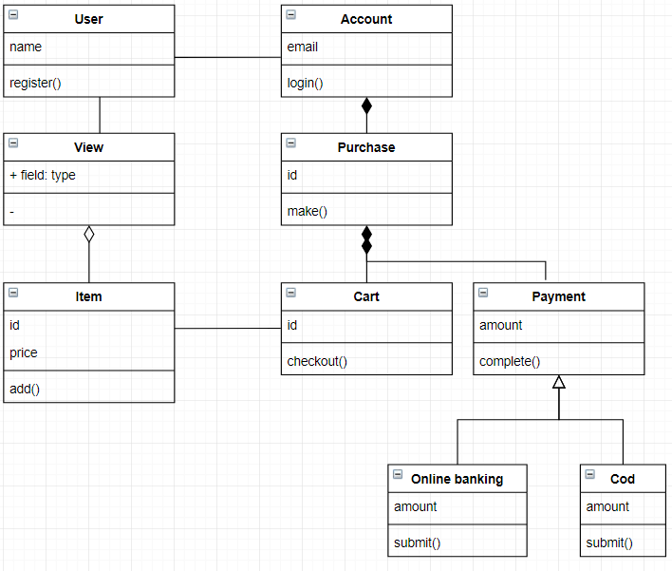
ANSWER FOR CLASS ACTIVITY 2

Slide 70
BEHAVIORAL STATE MACHINE DIAGRAM

Slide 71
BEHAVIORAL STATE MACHINE DIAGRAM
https://www.youtube.com/watch?v=7kdKcYSYM0E
Behavioral state machine diagram is a dynamic diagramming model that shows different states of a single class passes through during its life in response to events along with its responses and actions.
Typically behavioral state machine diagram are not used for all classes, but just to further define complex classes to help simplify the design of algorithm for their methods.
The behavioral state machine diagram shows the different states of the class and what events cause the class to change from one state to another.

Slide 72


ELEMENTS OF BEHAVIORAL STATE MACHINE DIAGRAM
Term & definition | Symbol
1. A state A set of values that describes an object at a specific point of time. Represented by a rectangle with rounded corners and a descriptive label written in it.
2. An initial state The point at which an object begins to exist. Shown as a small filled-in circle.
3. A final state Is used to represent the completion of activity. Shown as a circle included with a small filled-in circle (bull’s eye).

Slide 73

ELEMENTS OF BEHAVIORAL STATE MACHINE DIAGRAM
Term & definition | Symbol
4. An event A nameable occurrence that triggers a change in a state. Examples of occurrence such as: activity or action taken from an object, or (condition becoming true), or (the passage of a designated period). It is used to label a transition which the event name will be written on the top of arrow.
5. A transition arrow An arrow will be used to indicate the transition of an object in an initial state will enter the next state. Is triggered by the occurrence of the event labeling the transition. Shown as a solid line with arrow pointing from one state to another (use the directed association from class diagram) labeled by the event name.

Slide 74
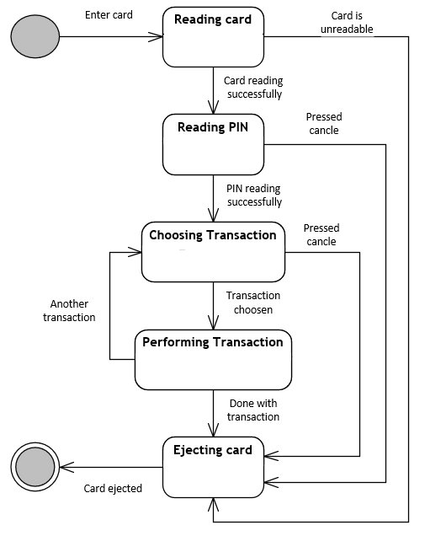
EXAMPLE OF A BEHAVIORAL STATE MACHINE DIAGRAM

Slide 75
CREATING A BEHAVIORAL STATE MACHINE DIAGRAM
Steps in creating a behavioural state machine diagram
Identify the states
Identify the transitions

Slide 76
LETS TRY TO DRAW
Create a behavioral state machine diagram that illustrate the following example of states.
The life of an Order of Tune Source Digital Music Project:
Customer adds items to shopping cart.
Customer checks out and submits purchase once he/she is finished.
Purchase is pending while payment is authorized.
Payment is approved.
Purchase is pending for final customer approved.
Customer confirms the purchase.
The download is release.

Slide 77
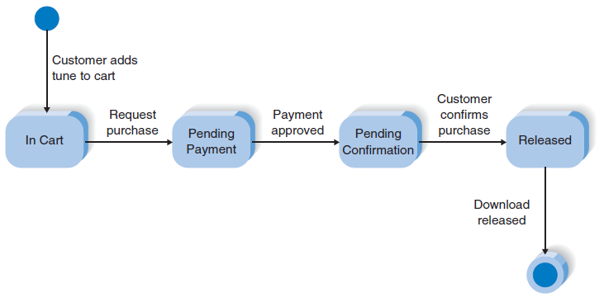
LETS TRY TO DRAW
Create a behavioral state machine diagram that illustrate the following example of states.
The life of an Order of Tune Source Digital Music Project: (Answer)

Slide 78
SUMMARY OF MAJOR UML DIAGRAMMING
UML is a standard set of diagramming techniques for object-oriented system analysis and design.
It exposes the analyst to use object-oriented approach in viewing a system as a collection of self-contained objects that have both data and process.
Objects are grouped into classes which are collection of objects that share common properties (attributes) and methods (operations).
Objects communicate with each other by sending messages, which trigger methods.
The major UML diagramming such as use case diagram, sequence diagram, class diagram, and behavioral state machine diagram.

Slide 79
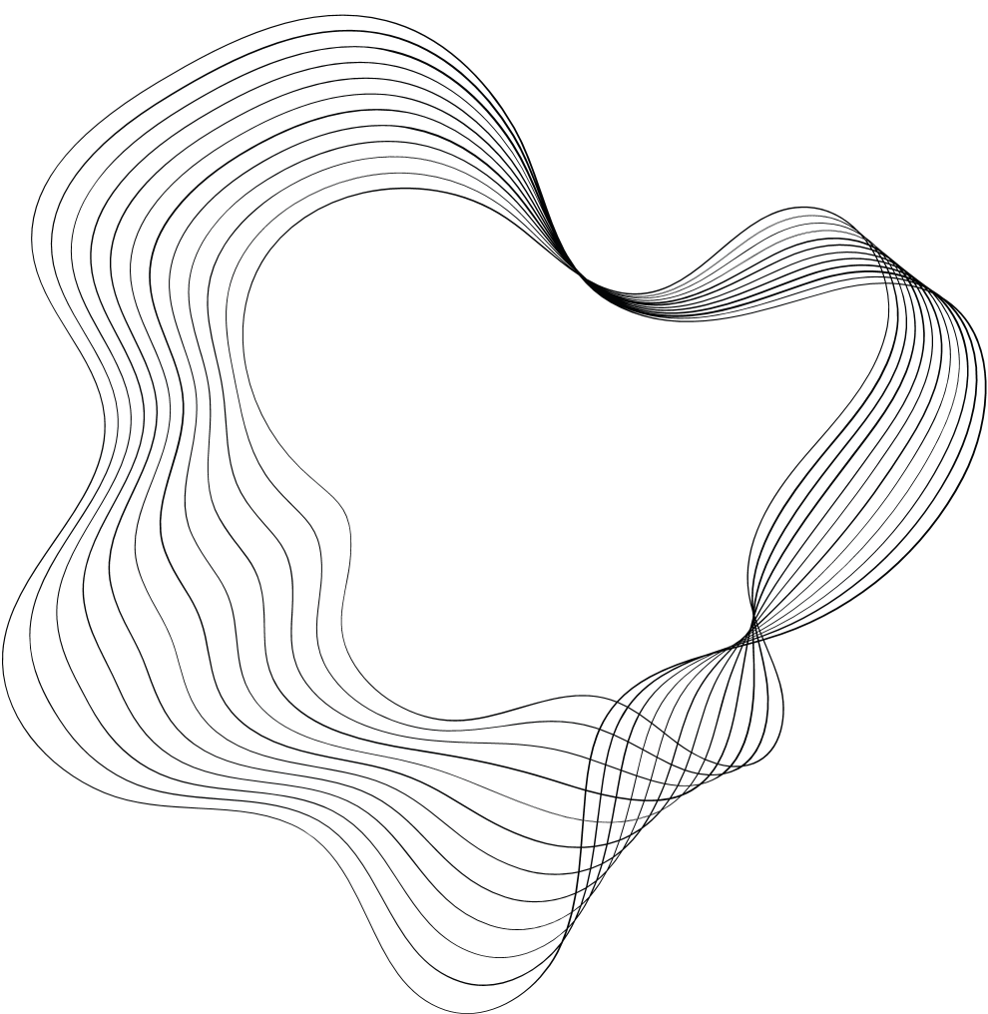


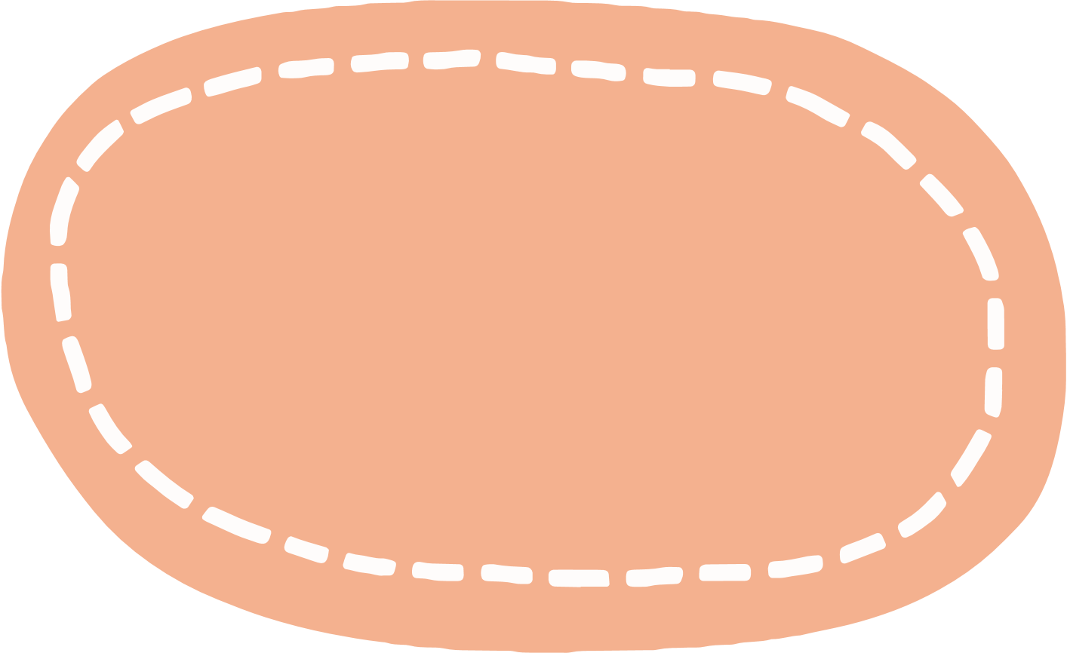



Question Time

